Slide 1
Department of CSE H
Probability statistics and queuing theory
22mt2005
Topic
Random Variables, Probability functions and Cumulative distribution Function
Session - 4

Slide 2




AIM OF THE SESSION
To familiarize students with the rules of different probability distribution functions
INSTRUCTIONAL OBJECTIVES
This Session is designed to:
Demonstrate the concept of Random variables and its types
List out the rules of discrete probability and continuous probability functions
Describe the Cumulative distribution function
LEARNING OUTCOMES
At the end of this session, you should be able to:
Identify the different types of random variables .
Write the rules of Probability functions and its properties
Differentiate the Cumulative distribution function from other functions.

Slide 3
Random Variables
Random In an experiment of chance, outcomes occur randomly. We often summarize the outcome from a random experiment by a simple number.
Variable is a symbol such as X or Y that assumes values for different elements. If the variable can assume only one value, it is called a constant.
Random variable: A function that assigns a real number to each outcome in the sample space of a random experiment. (Denote by an uppercase letter : X, Y, Z etc.,)
Example: A balanced coin is tossed two times. List the elements of the sample space, the corresponding probabilities and the corresponding values X, where X is the number of getting head.
Let X be a random variable that the number of getting heads
X: HH HT TH TT
X=x: 2 1 1 0
P(X=x) 1/4 1/4 1/4 1/4

Slide 4
Types of Random Variables
Discrete Random Variables: A random variable is discrete if its set of possible values consist of discrete points on the number line.
Example
number of defective parts among 1000 tested , number of transmitted bits received error, number of scratches on a surface
Continuous Random Variables : A random variable is continuous if its set of possible values consist of an entire interval on the number line.
Example:
Time, Temperature, Height, Weight, Length, Electrical current

Slide 5
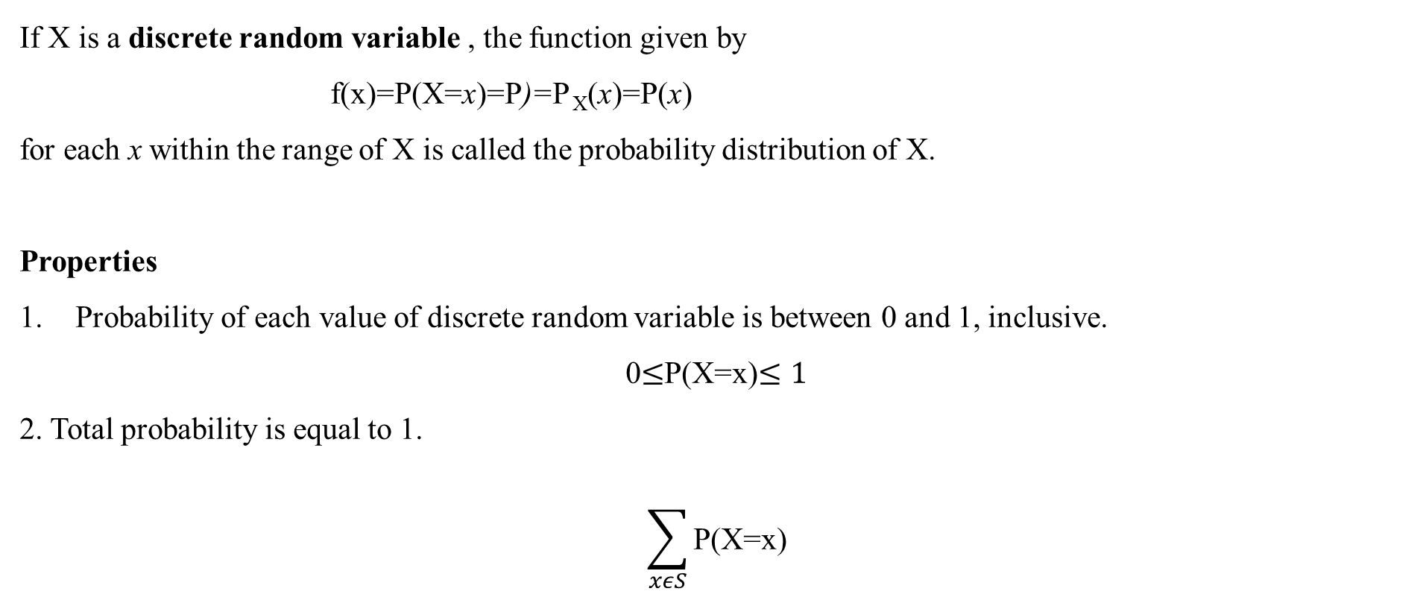
Discrete Probability Distribution Function
If X is a discrete random variable , the function given by
f(x)=P(X=x)=P)=P _{X}(x)=P(x)
for each x within the range of X is called the probability distribution of X.
Properties
Probability of each value of discrete random variable is between 0 and 1, inclusive.
0$≤$P(X=x)$≤1$
2. Total probability is equal to 1.
$$\sum_{xεS}{\text{P}\text{(}\text{X}\text{=}\text{x}\text{)}}$$

Slide 6
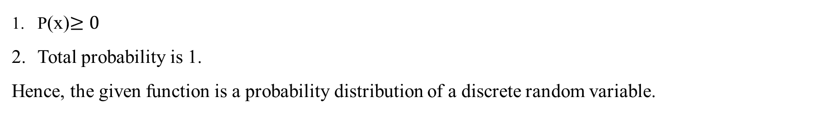
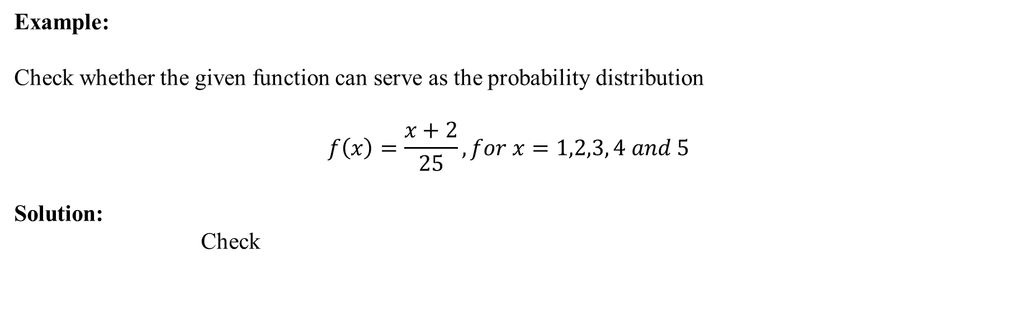
Example: Discrete probability distributions
Example:
Check whether the given function can serve as the probability distribution
$$f\left(x\right)=\frac{x+2}{25}, for x=1,2,3, 4 and 5$$
Solution:
Check
P(x)$≥0$
Total probability is 1.
Hence, the given function is a probability distribution of a discrete random variable.
By substituting any value of x in the given function is non-negative. Hence, Condition (1) is satisfied
Now we have to verify the condition (2)

Slide 7

Discrete probability distributions
$$=\sum_{x=1}^{5}{f\left(x\right)}=\sum_{x=1}^{5}{\frac{x+2}{25}}$$
$=f\left(1\right)+f\left(2\right)+f\left(3\right)+f\left(4\right)+f\left(5\right)$
$=\frac{1+2}{25}+\frac{2+2}{25}+\frac{3+2}{25}+\frac{4+2}{25}+\frac{5+2}{25}$
= (3/25)+(4/25)+(5/25)+(6/25)+(7/25)
=1

Slide 8
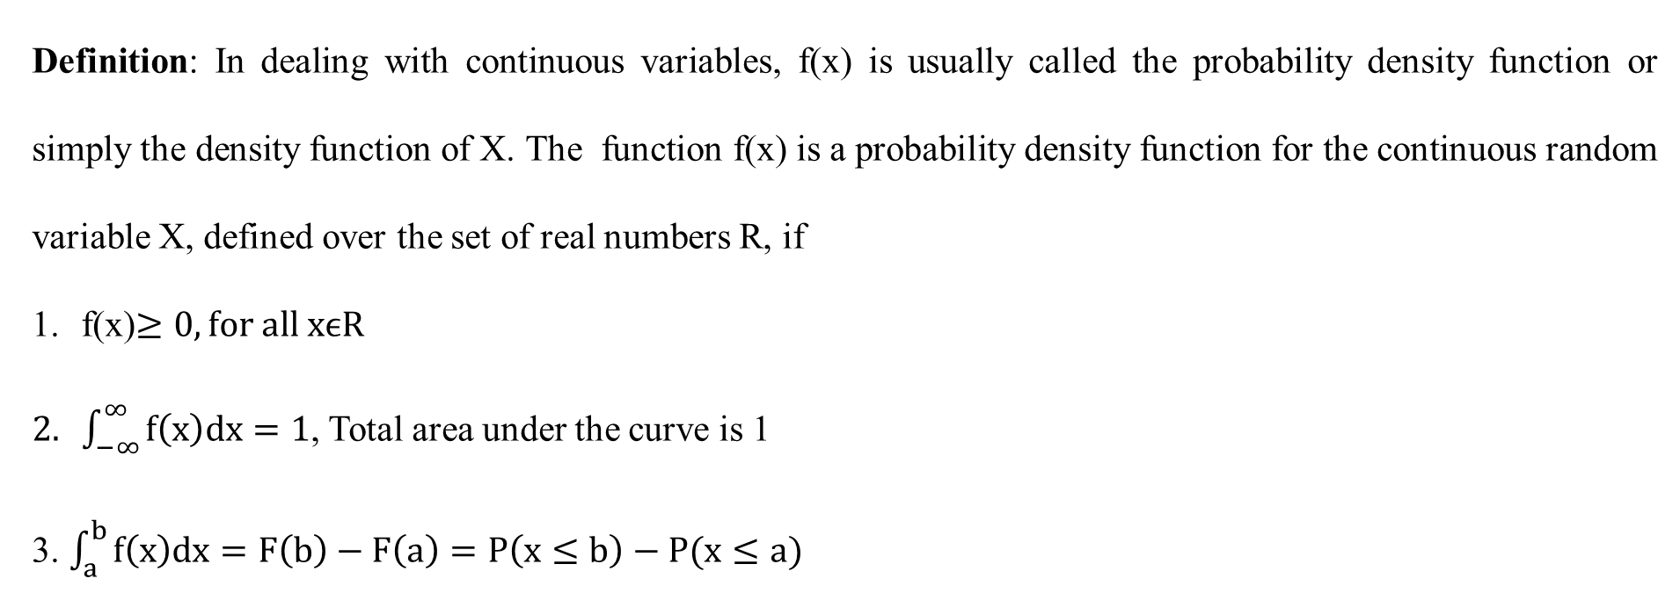
CONTINUOUS PROBABILITY DISTRIBUTIONS
Definition: In dealing with continuous variables, f(x) is usually called the probability density function or simply the density function of X. The function f(x) is a probability density function for the continuous random variable X, defined over the set of real numbers R, if
f(x)$≥0, for all xϵR$
$\int_{−∞}^{∞}{f\left(x\right)dx}=1$, Total area under the curve is 1
3. $\int_{a}^{b}{f\left(x\right)dx}=F\left(b\right)−F\left(a\right)=P\left(x≤b\right)−P(x≤a)$

Slide 9
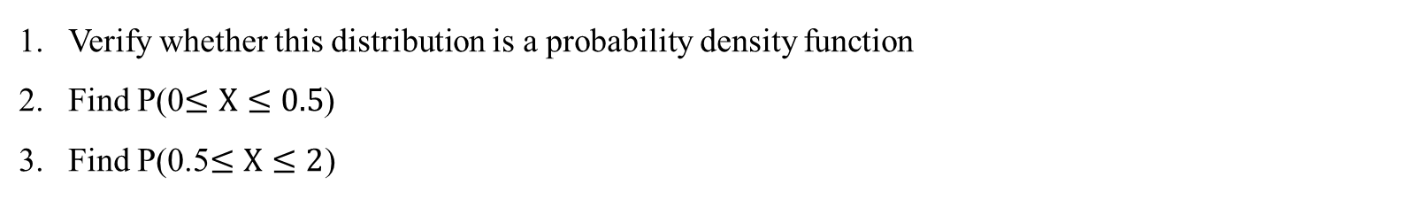

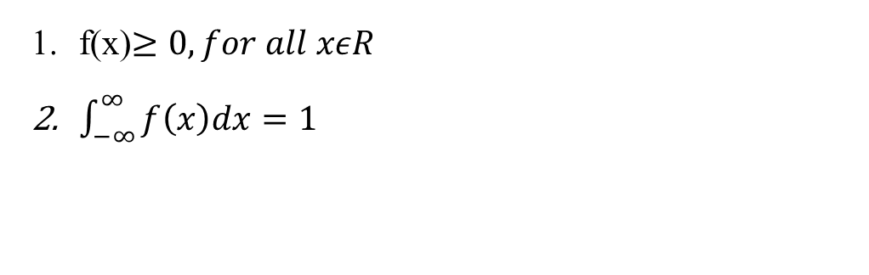
Example: CONTINUOUS PROBABILITY DISTRIBUTIONS
Example Let X be a continuous random variable with the following
$$f\left(x\right)=\left\{\begin{matrix}\frac{3}{4}\left(x^{2}+1\right), 0≤x≤1 \\ o otherwise\end{matrix}\right.$$
Verify whether this distribution is a probability density function
Find P(0$≤X≤0.5$)
Find P(0.5$≤X≤2$)
Solution: The distribution is probability density function if it fulfill the following requirements,
f(x)$≥0, for all xεR$
$\int_{−∞}^{∞}{f\left(x\right)dx}=1$

Slide 10


CONTINUOUS PROBABILITY DISTRIBUTIONS
In this problem,
First requirement
f(0)=3/4≥0,
f(1)=3/2≥0,
f(x)=0, otherwise
$∴$ f(x)≥0
Must write the conclusion so that we know the first requirement is fulfill!

Slide 11


CONTINUOUS PROBABILITY DISTRIBUTIONS
$$∴\int_{−∞}^{∞}{f\left(x\right)dx=1}$$
2) Second requirement
$$\int_{−∞}^{0}{f\left(x\right)dx+}\int_{0}^{1}{f\left(x\right)dx+}\int_{1}^{ꝏ}{f\left(x\right)dx}$$
$=\int_{−∞}^{0}{0dx+}\int_{0}^{1}{\frac{3}{4}\left(x^{2}+1\right)dx+}\int_{1}^{ꝏ}{0dx}$
$$=\frac{3}{4}{\left[\frac{x^{3}}{3}+x\right]}_{0}^{1}$$
$$=\frac{3}{4}\left[\frac{4}{3}\right]=1$$
$$∴\int_{−∞}^{∞}{f\left(x\right)dx=1}$$
Must write the conclusion so that we know the second requirement is fulfill!
Since all requirements are fulfil. Hence the given function is probability density function.

Slide 12
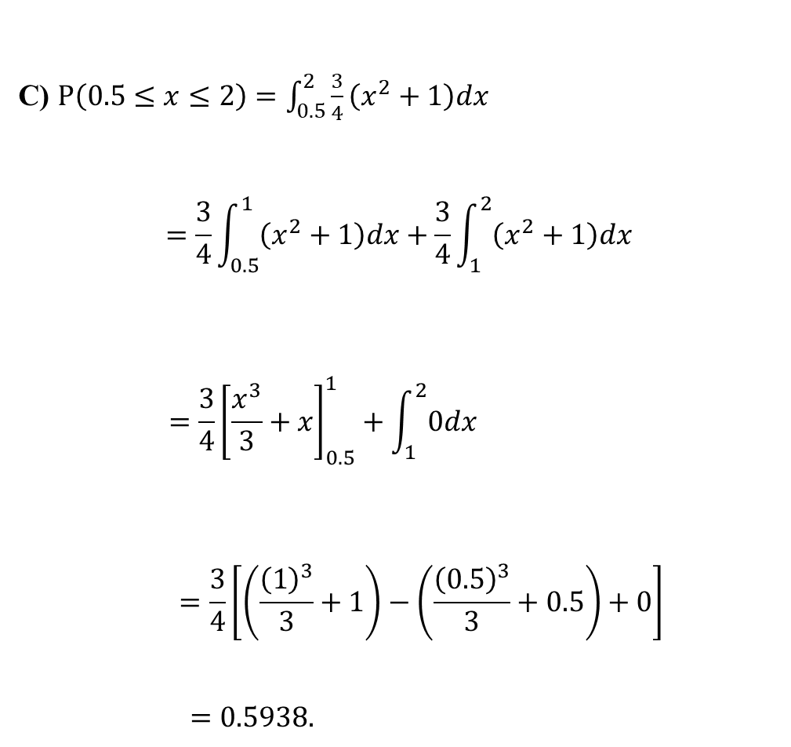

$$P\left(0≤x≤0.5\right)=\int_{0}^{0.5}{\frac{3}{4}\left(x^{2}+1\right)dx}$$
$$=\frac{3}{4}\int_{0}^{0.5}{\left(x^{2}+1\right)dx}$$
$$=\frac{3}{4}{\left[\frac{x^{3}}{3}+x\right]}_{0}^{0.5}$$
$$=\frac{3}{4}\left[(\frac{{(0.5)}^{3}}{3}+0.5)−0\right]$$
$=0.4063.$
C) $P\left(0.5≤x≤2\right)=\int_{0.5}^{2}{\frac{3}{4}\left(x^{2}+1\right)dx}$
$$=\frac{3}{4}\int_{0.5}^{1}{\left(x^{2}+1\right)dx+\frac{3}{4}}\int_{1}^{2}{\left(x^{2}+1\right)dx}$$
$$=\frac{3}{4}{\left[\frac{x^{3}}{3}+x\right]}_{0.5}^{1}+\int_{1}^{2}{0dx}$$
$$=\frac{3}{4}\left[\left(\frac{{\left(1\right)}^{3}}{3}+1\right)−\left(\frac{{\left(0.5\right)}^{3}}{3}+0.5\right)+0\right]$$
$=0.5938.$
b)

Slide 13

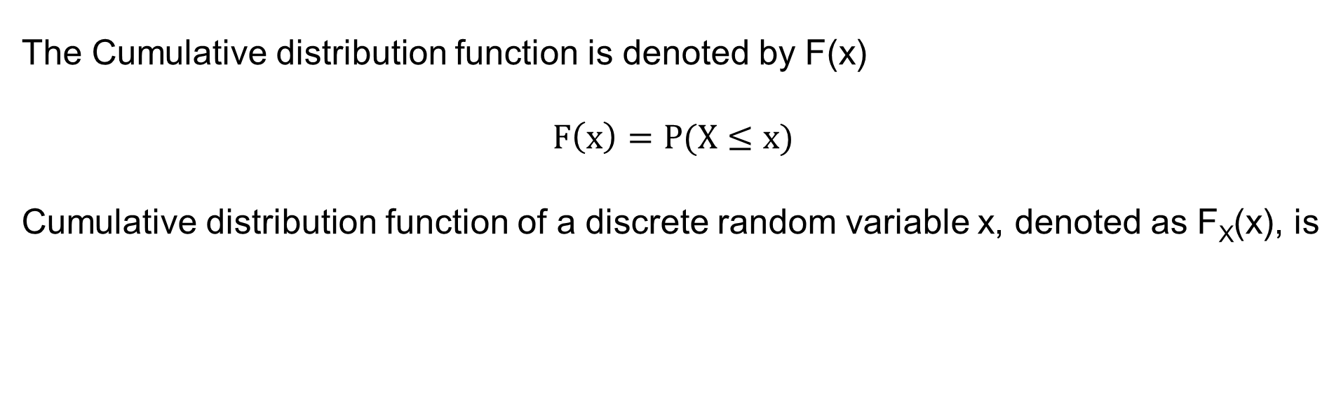

CUMULATIVE DISTRIBUTION FUNCTION
The Cumulative distribution function is denoted by F(x)
$$F\left(x\right)=P(X≤x)$$
Cumulative distribution function of a discrete random variable x, denoted as F_{X}(x), is
$$F\left(x\right)=P\left(X≤x\right)=\sum_{t≤x}{f\left(t\right)}$$
Cumulative distribution function of a discrete random variable x, denoted as F_{X}(x), is
$$F\left(x\right)=P\left(X≤x\right)=\int{f\left(t\right)dt}$$

Slide 14
CUMULATIVE DISTRIBUTION FUNCTION
For a random variable X, F(x) satisfies the following
1) 0 ≤ F (x) ≤ 1
2) If x ≤ y, then F (x) ≤ F ( y)
3) F(-ꝏ)=0
4)F(ꝏ)=1

Slide 15
EXAMPLE-CDF
The time to recharge the flash is tested in three cell phone cameras. The probability a camera passes the test is 0.8 and the camera perform independently. List the elements of the sample space, the corresponding probabilities and the corresponding values X, where X denotes the number of camera passes the test.
Solution: X : the number of cameras that pass the test
Camera 1 | Camera 2 | Camera 3 | Probability P(x) | X
Pass | Pass | Pass | 0.512 | 3
Pass | Pass | Fail | 0.128 | 2
Pass | Fail | Pass | 0.128 | 2
Pass | Fail | Fail | 0.032 | 1
Fail | Pass | Pass | 0.128 | 2
Fail | Pass | Fail | 0.032 | 1
Fail | Fail | Pass | 0.032 | 1
Fail | Fail | Fail | 0.008 | 0

Slide 16
EXAMPLE-CDF
x: 0 1 2 3
f(x): 0.008 0.096 0.384 0.512
F(x): 0.008 0.104 0.488 1

Slide 17
Activity
Check whether the distribution is a probability distribution.
X | 0 | 1 | 2 | 3 | 4
P(X=x) | 0.125 | 0.375 | 0.025 | 0.375 | 0.125
∑ P( X = x) = P( X = 0) + P( X = 1) + P( X = 2) + P( X = 3) + P( X = 4)
0
= 0.125+0.375+0.025+0.375+0.125
= 1.025
≠ 1
Since the summation of all probabilities is not equal to 1, so the distribution is not a probability distribution

Slide 18
SUMMARY
In this session, identify the different types of random variables, probability functions and their properties have discussed.
1. Difference between discrete and continuous random variables
2. Probability Mass and Probability density function and their properties
3. Cumulative distribution function and its properties.

Slide 19
SELF-ASSESSMENT QUESTIONS
The milk produce by a cow is
discrete random variable
continuous random variable
neither discrete nor continuous random variable
continuous as well as discrete random variable.
The probability of all possible outcomes of a random experiment is always equal to:
Infinity
zero
one
none of the above

Slide 20
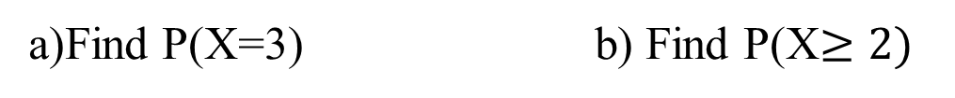
TERMINAL QUESTIONS
A Random variable X can assume 0,1,2,3,4. A Probability distribution is shown here
X | 0 | 1 | 2 | 3 | 4
P(X) | 0.1 | 0.3 | 0.3 | ? | 0.1
a)Find P(X=3) b) Find P(X$≥2)$
2. Given that f(x)=k/2^{x} is a probability distribution for a random variable that can take on the values x=0, 1, 2, 3 and 4. Find K.
Find K
Find the Cumulative probability distribution F(x)

Slide 21

TERMINAL QUESTIONS
3. A shipment of 8 similar microcomputers to a retail outlet contains 3 defectives. If a school makes a random purchase of 2 of these computers, find the probability distribution for the number of defectives.
4. Given that
$$f\left(x\right)=\left\{\begin{matrix}k\sqrt{x}, 0<x<1 \\ 0 otherwise\end{matrix}\right.$$
Evaluate k.
Evaluate P(0.3<X<0.6) using the density function

Slide 22

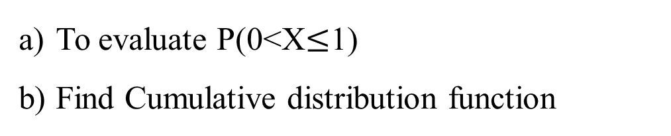
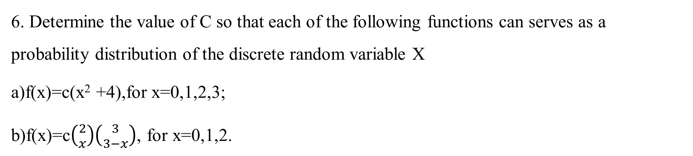
TERMINAL QUESTIONS
5. For the density function
$$f\left(x\right)=\left\{\begin{matrix}\frac{x^{2}}{3}, −1<x<2 \\ 0 otherwise\end{matrix}\right.$$
To evaluate P(0<X$≤$1)
Find Cumulative distribution function
6. Determine the value of C so that each of the following functions can serves as a probability distribution of the discrete random variable X
a)f(x)=c(x² +4),for x=0,1,2,3;
b)f(x)=c$\left({2 \atop x}\right)\left({3 \atop 3−x}\right)$, for x=0,1,2.

Slide 23
REFERENCES FOR FURTHER LEARNING OF THE SESSION
Reference Books:
1. Chapter 1 of TP1: William Feller, An Introduction to Probability Theory and Its Applications: Volume 1, Third Edition, 1968 by John Wiley & Sons,Inc.
2. Richard A Johnson, Miller& Freund’s Probability and statistics for Engineers, PHI, New Delhi, 11th Edition (2011).
Sites and Web links:
* https://ncert.nic.in/textbook.php?kemh1=16-16 *
Notes: sections 1 to 1.3 of http://www.statslab.cam.ac.uk/~rrw1/prob/prob-weber.pdf
https://ocw.mit.edu/courses/res - 6 -012 -introduction -to -probability - spring - 2018/91864c7642a58e216e8baa8fcb4a5cb5_MITRES_6_012S18_L01.pd f 9
https://www.probabilitycourse.com/chapter3/3_2_1_cdf.php
https://en.wikipedia.org/wiki/Cumulative_distribution_function

Slide 24



THANK YOU
Team – PSQT EVEN SEMESTER 2023-24

